Slide 1
On The Relevance of Negative And Positive Rights in Development New Empirical Evidence (1975-2007)
Jean-Pierre Chauffour
Lead Economist, World Bank
GWU, April 8, 2011

Slide 2
Development?

Slide 3
Growth Commission Report (2008)
Characteristics of 13 economies that have been able to grow at more than 7% for a period of 25 years since 1950:
Leadership and governance
Engagement with the global economy
High rates of investment and savings
Mobile resources, especially labor
Inclusiveness to share globalization benefits

Slide 4
How to achieve those outcomes?
Why do countries differ in terms of:
Factor accumulation and innovation
Level of schooling
Quality of infrastructure
Health of the population
Other proximate factors of economic growth
Why on average certain countries create better institutions, promote better policies, and achieve better outcomes?

Slide 5
Institutions?

Slide 6
Only two possible sets of factors
Exogenous factors
Geography and location
Natural resource endowment
Ethno linguistic homogeneity
Various other types of good and bad luck
Endogenous factors
Free individual choices
Coerced individual decisions

Slide 7
Freedom vs. entitlement
Negative rights (freedom from)
Economic freedom
Civil rights and political liberties
Positive “rights” (entitlement to)
Regulations, taxation, government interventions
Public goods
Various economic and social entitlements

Slide 8
Freedom vs. entitlement

Slide 9
Uganda vs. Zimbabwe

Slide 10
Model specification
Dyi is the average growth of per capita GDP of country i
Y₀ is the initial level of GDP
EFio, CPRi0, and SEi0 are the initial levels of the economic freedom index, civil and political rights index, and social entitlement index
dEF, dCPR, and dSE are changes in the respective indexes over the period under investigation
X_{i} is a vector of control exogenous variables
Tropics represents the extent of land located in the geographical tropics
Remoteness measures the average distance to world markets
Pop100K indicates the proportion of population living within 100 km of the coastline or ocean-navigable river
Resources is a dummy variable for countries with subsoil assets

Slide 11
Data
The index of economic freedom (EF) is the simple average of four of the five areas of the Fraser Institute’s Economic Freedom of the World (EFW), namely the legal structure and security of property rights, access to sound money, the freedom to trade internationally, and the regulation of credit, labor and business.
The index of civil and political rights (CPR) is computed as the simple average of Freedom House’s Civil Rights (CR) and Political Liberties (PL) indices. Civil rights indicates whether citizens are able to participate freely in the political process, compete for public office, join political parties and organizations, and elect their representatives. Political liberties allow for freedom of expression and belief, association and organization rights, rule of law and personal autonomy.
The index of social entitlement (SE) is computed from the fifth area of the Fraser Institute’s Economic Freedom of the World. It is a measure of the size of government in providing goods, services and other social entitlements beyond the minimal state. It includes the general government consumption spending as a percentage of total consumption, transfers and subsidies as a percentage of GDP, government enterprises and investment, and top marginal tax rate.

Slide 12
Civil rights vs. political liberties
Where 8 indicates the highest level of civil rights and political liberties,
and the size of bubbles represent the number of countries.
Source: Freedom House, 2007.
Where 8 indicates the highest level of civil rights and political liberties,
and the size of bubbles represent the number of countries.
Source: Freedom House, 2007.
Where 8 indicates the highest level of civil rights and political liberties,
and the size of bubbles represent the number of countries.
Source: Freedom House, 2007.
8
6
PR
4
2
0
0
2
4
6
8
CL
Where 8 indicates the highest level of civil rights and political liberties, and the size of bubbles represent the number of countries.
Source: Freedom House, 2007.

Slide 13
CPRs vs. per Capita Income
Source: Freedom House and World Bank, 2007

Slide 14
ESCRs vs. per Capita Income
Source: Fraser Institute and World Bank, 2007

Slide 15
Economic freedom vs. per Capita Income
Source: Fraser Institute and World Bank, 2007

Slide 16
Results
 | Coefficient | Coefficient | Coefficient | Coefficient | Coefficient | Coefficient | Coefficient
Column | 1 | 2 | 3 | 4 | 5 | 6 | 7
EF | 1.099*** |  |  | 0.946*** | 1.071*** |  | 0.969***
dEF 1985-1994 | 1.335*** |  |  | 1.250*** | 1.045*** |  | 1.375***
dEF 1995-2004 | 0.994*** |  |  | 0.827*** | 1.047*** |  | 0.928***
CPR |  | 0.562*** |  | 0.428*** |  | 0.446*** | 0.332**
dCPR 1985-1994 |  | 0.426** |  | 0.328* |  | 0.335 | 0.230
dCPR 1995-2004 |  | 0.267* |  | 0.210 |  | 0.264* | 0.127
SE |  |  | -0.255* |  | -0.111 | -0.192 | -0.524
dSE 1985-1994 |  |  | 0.013 |  | 0.108 | 0.029 | 0.121
dSE 1995-2004 |  |  | 0.016 |  | 0.308** | 0.026 | 0.283*
initial GDP per capita | -0.740*** | -0.585*** | -0.290** | -0.868*** | -0.766*** | -0.496*** | -0.879***
Tropics | -1.694*** | -2.179*** | -2.413*** | -1.660*** | -1.803*** | -2.343*** | -1.748***
Resources | 0.526 | 0.625 | -0.099 | 1.041** | 1.069** | 0.616 | 1.360**
Pop100km | 1.286*** | 1.660*** | 2.082*** | 0.813* | 1.279*** | 1.599*** | 0.922*
Remoteness | -0.148** | -0.190** | -0.201** | -0.125* | -0.127* | -0.170** | -0.110
Constant | -5.202*** | -1.281* | 1.934** | -5.733*** | -7.370*** | 0.181 | -5.121***
No of countries | 98 | 109 | 105 | 97 | 98 | 103 | 97
Adjusted R-sq: | 0.562 | 0.429 | 0.405 | 0.588 | 0.599 | 0.429 | 0.608

Slide 17
Conclusion
Goal(i) = F (Right1, Right2, Right3, …)

Slide 18
Thank you

Slide 19
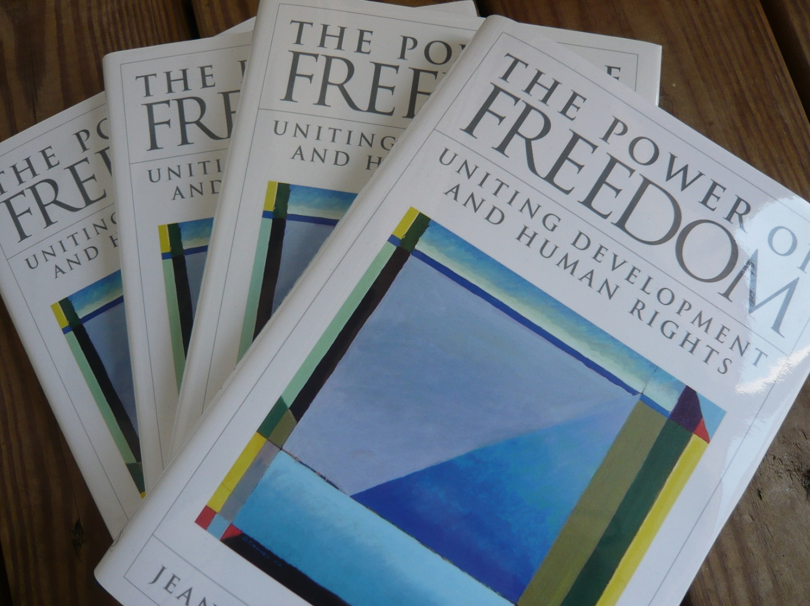
For more, www.amazon.com

